Slide 1
CS 35L Software Construction Lab Week 5 – Lab

Slide 2
Memory Allocation
Dynamically – on the Heap

Slide 3
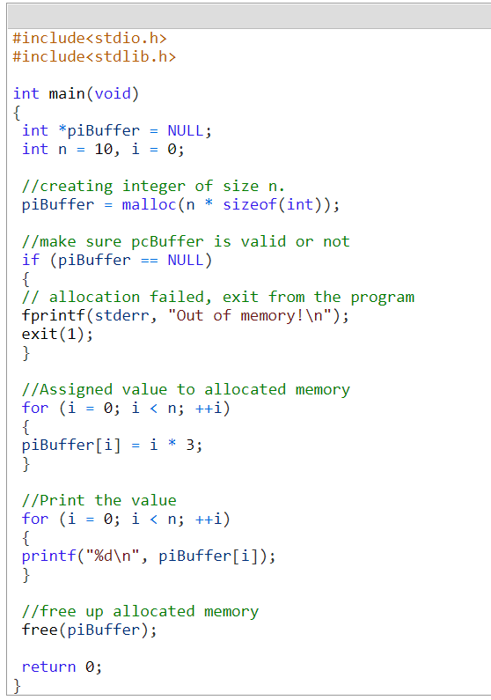
Check for NULL after malloc

Slide 4
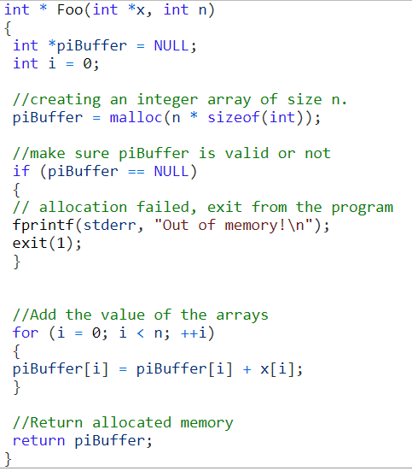
Malloc does not initialize – calloc does

Slide 5
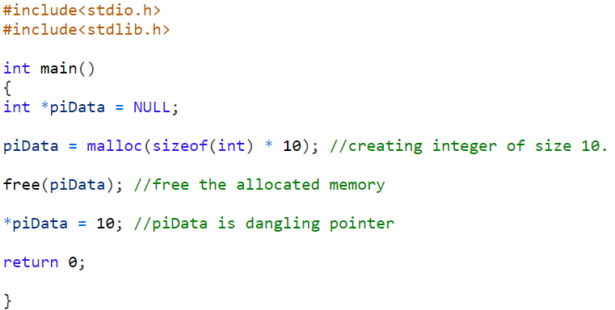
Any
attempt to read or write the freed pointer can cause code to crash

Slide 6
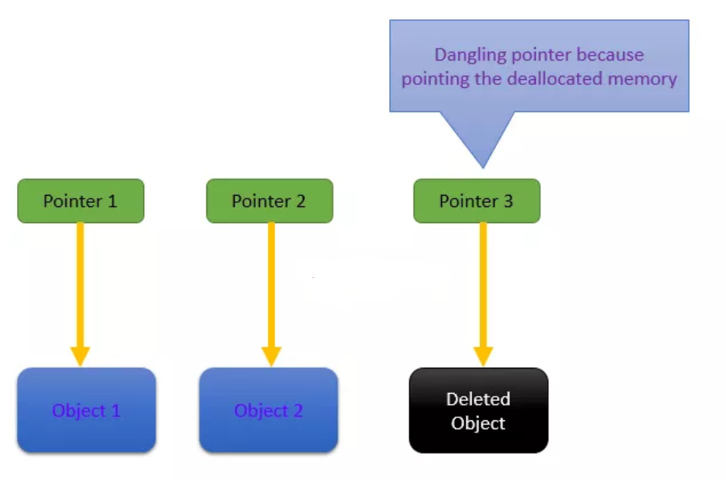
Dangling Pointer

Slide 7
Lab 4
Download old version of coreutils with buggy ls program
Untar, configure, make
Bug: ls -t mishandles files whose time stamps are very far in the past. It seems to act as if they are in the future
$ tmp=$(mktemp -d)
$ cd $tmp
$ touch -d ‘1918-11-11 11:00 GMT’ wwi-armistice
$ touch now
$ sleep 1
$ touch now1
$ ls -lt –full-time wwi-armistice now now1
Correct Output:
-rw-r--r-- 1 eggert csfac 0 2018-10-29 16:43:16.805404419 +0000 now1
-rw-r--r-- 1 eggert csfac 0 2018-10-29 16:43:15.801376773 +0000 now
-rw-r--r-- 1 eggert csfac 0 1918-11-11 11:00:00.000000000 +0000 wwi-armistice

Slide 8
Steps
Wget the coreutils
Untar
Configure --prefix
Make
Throws error
Get the patch (wget)
Edit the patch (just delete ~ from your coreutils patch file)
Apply the patch [use p0] (you must have figured it out that 5 files have been patched)
Build it
Reproduce the bug
Find the bug using gdb (for bin/ls in the dir you created ) and fix it (info functions and info locals)
Produce the patch
Test it

Slide 9
Goal: Fix the Bug
Reproduce the Bug
Follow steps on lab web page
Simplify input
Run ls with –l and –t options only
Debug
Use gdb to figure out what’s wrong
$ gdb ./ls
(gdb) run –lt wwi-armistice now now1
(run from the directory where the compiled ls lives)
Patch
Construct a patch “lab4.diff” containing your fix
It should contain a ChangeLog entry followed by the output of diff -u

Slide 10
Lab Hints
Use “info functions” to look for relevant starting point
Use “info locals” to check values of local variables
Compiler optimizations: -O2 -> -O0
./configure CFLAGS="…-O0"

Slide 11
Homework 4
Write a C program called sfrob
Reads stdin byte-by-byte (getchar)
Consists of records that are space-delimited
Each byte is frobnicated (XOR with dec 42)
Sort records without decoding (qsort, frobcmp)
Output result in frobnicated encoding to stdout (putchar)
Dynamic memory allocation (malloc, realloc, free)

Slide 12
Example
Input: printf 'sybjre obl’
$ printf 'sybjre obl\n' | ./sfrob
Read the records: sybjre, obl
Compare records using frobcmp function
Use frobcmp as compare function in qsort
Output: obl
sybjre

Slide 13
Homework Hints
Array of pointers to char arrays to store strings (char ** arr)
Use the right cast while passing frobcmp to qsort
cast from void * to char ** and then dereference because frobcmp takes a char *
Use realloc to reallocate memory for every string and the array of strings itself, dynamically
Use exit, not return when exiting with error

